Slide 1
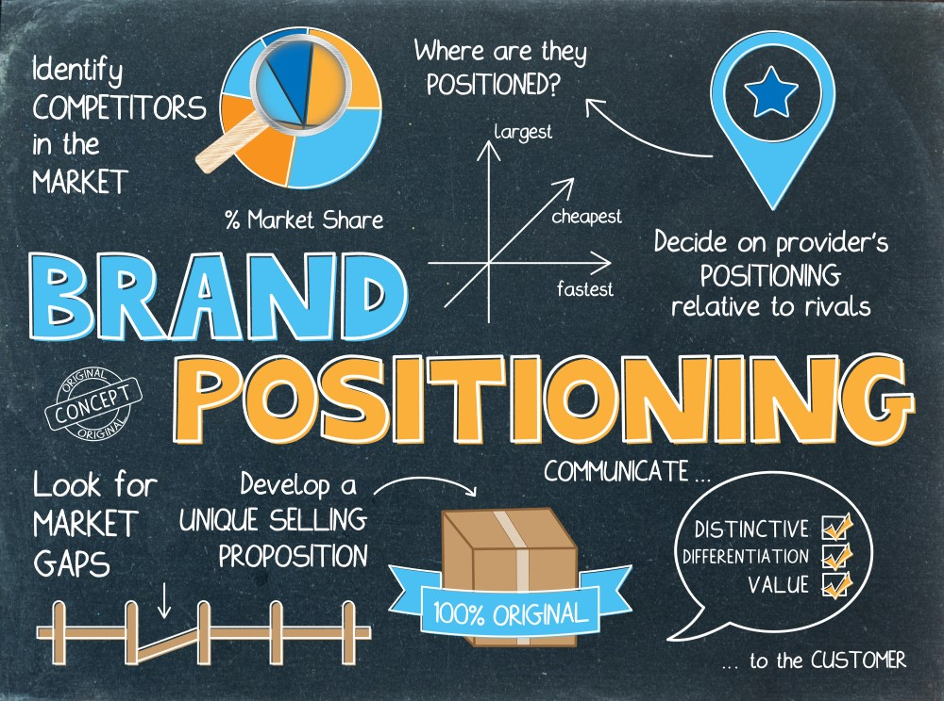
Facebook
Positioning Analysis
Presented By: - GROUP- 4
Duyen Thanh
Sayali Mahamulkar
Vishnu Nelapati
Vanshika Gupta
Mudit Mishra
Manogna Reddy
Wenting Hu

Slide 2
AGENDA
01
Introduction
02
Dimensions of Perceptual Data
03
Consumer Perception
Current & Future Positioning of the Product
04

Slide 3


Introduction
Objective
The challenge that the Facebook have today
Losing users
High Competition from other social media platforms
Multiple competitors – Tiktok, Instagram, Snapchat, etc.
01
Retain current users and acquire new users.
Notes:
Facebook is losing users for the first time ever and shares in Meta have fallen off a cliff, any further declines in the size of Facebook’s active users base may adversely impact the company’s ability to deliver ad impressions and, in turn, their financial performance.
In this fast-pacing world, where there are so many ways a person can or want to spend their time, there are many social media platforms and apps that Facebook is competing with. The management wondered how it might increase active users and retain current users on the app by repositioning Facebook.

Slide 4


Hello, our problem statement is...
How to increase active users and retain current users on Facebook?

Slide 5

Questionnaire & Survey

Slide 6
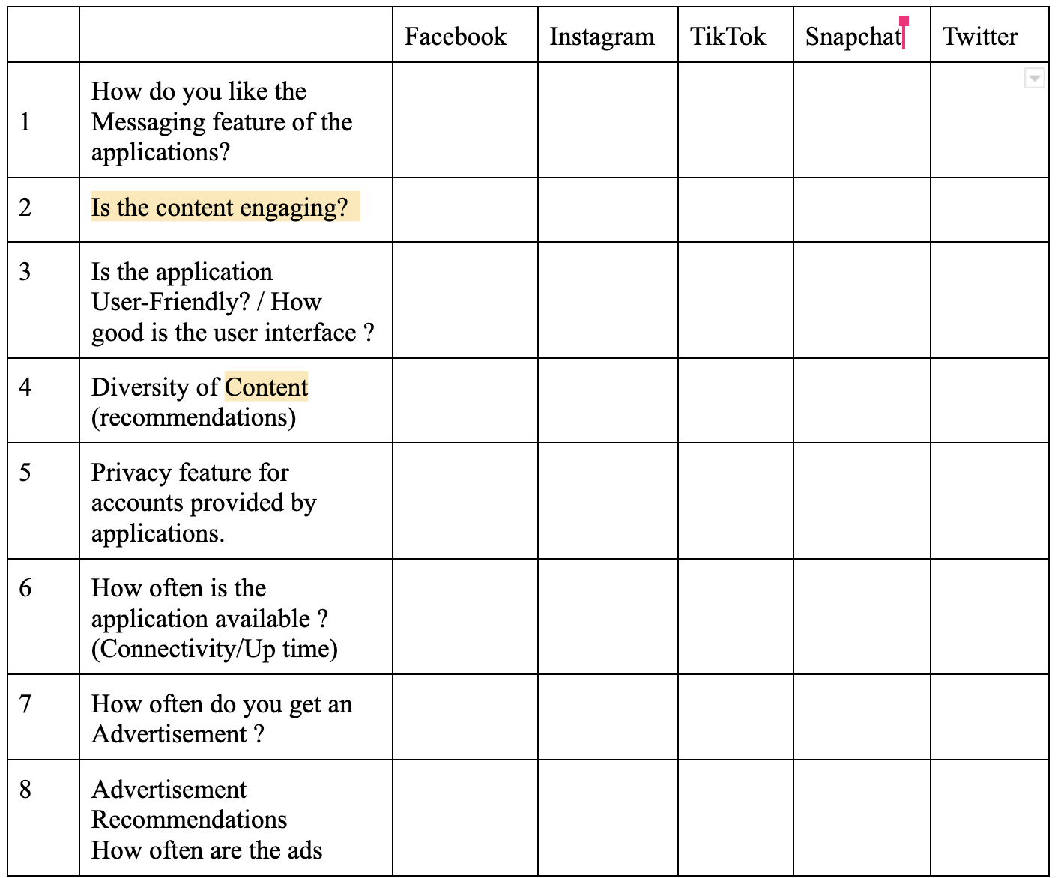
Questionnaire
Data Collection –
Survey participants: 143 users
10 Attributes for each of the social media platforms
Notes:
Survey
Position
Messaging
user-friendly
Content diversity
Privacy features
Connectivity
Advertisemnt recommendations
Censorship of content
LIke, Share & Comment features
Filters
Audio/video quality

Slide 7
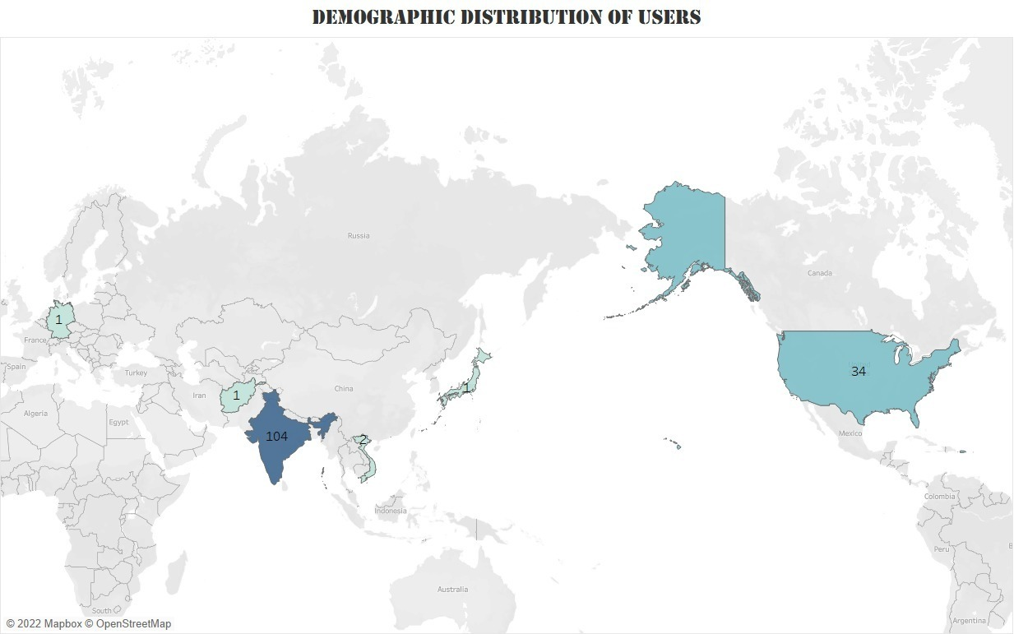
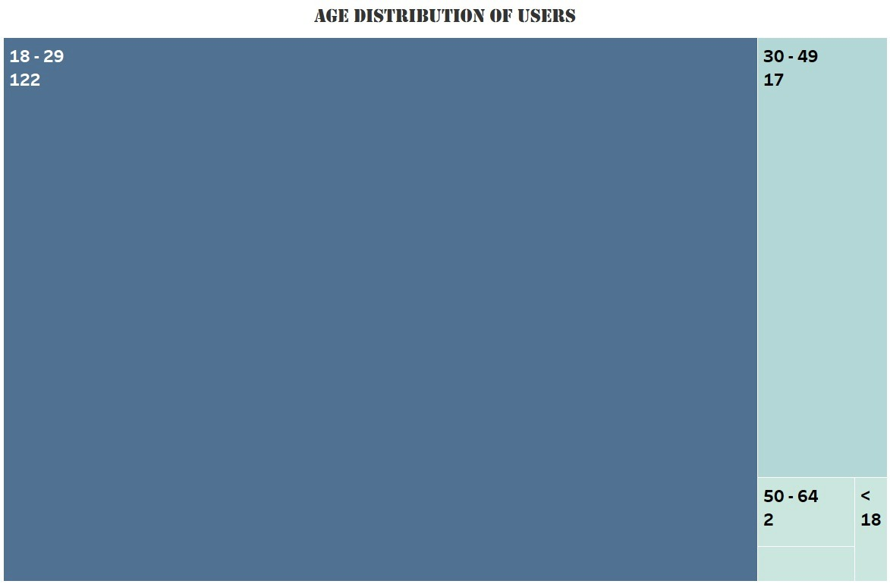
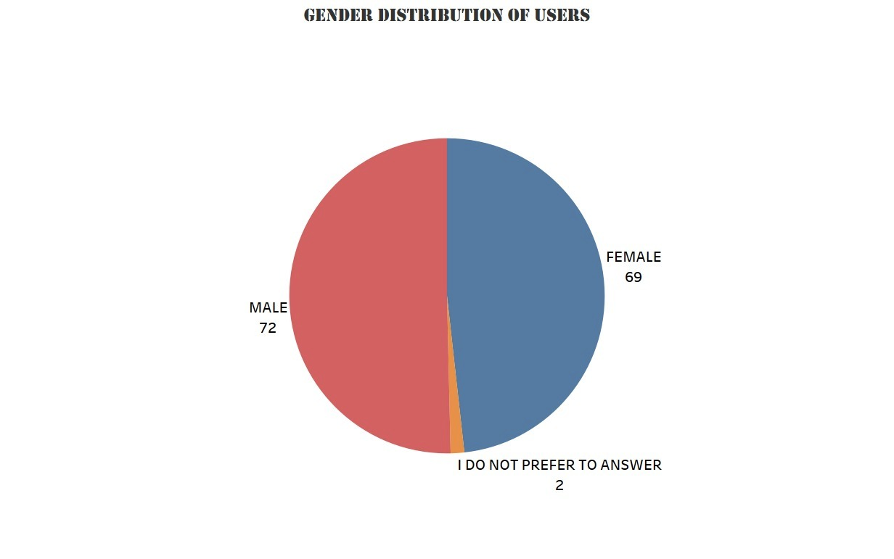
Survey - Users Analysis
Notes:
Survey
Position

Slide 8

DIMENSIONS

Slide 9
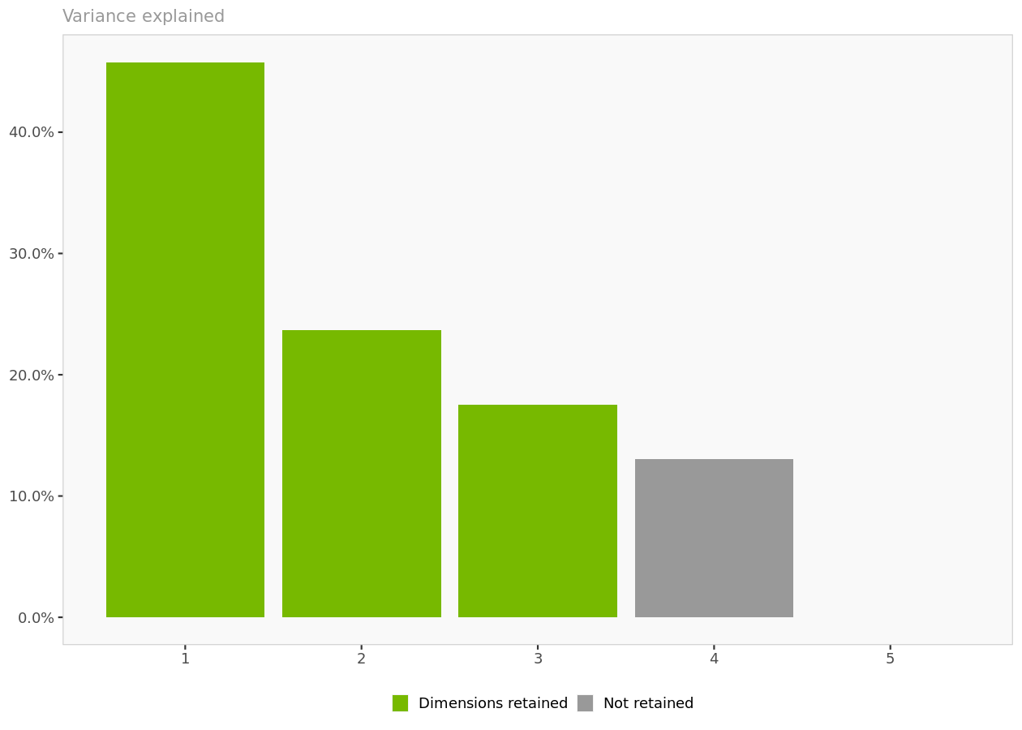
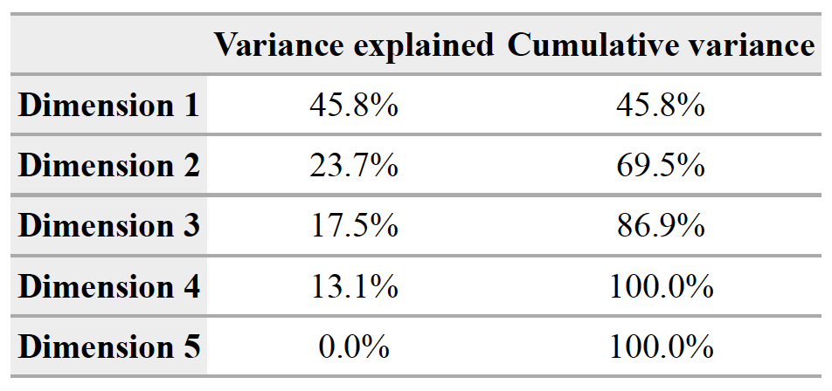
Number of dimensions retained & Variance
The first 2 dimensions of the positioning map explain 69.5% of the variance in the data. Consequently, the first 3 dimensions will be displayed. The third-dimension accounts for an additional 17.5% of the variance, for a total of 86.9%
Each additional dimension captures a decreasing portion of the variance found in the original data.

Slide 10
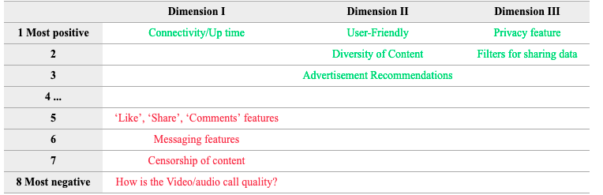
DIMENSIONS
Dimension I - CONNECTION
Dimension II - EASE OF USE
The attributes which are most captured by dimension 1 is [“Connectivity”]. The least captured attributes are [“Like, Share, Comment”, “Messaging”, “Censor”, “Video/Audio”]
The attributes which are most captured by dimension 2 are [“User friendly”, “Diversity of Content”, “Ads”]
Dimension III - CONFIDENTIAL
Cats use their whiskers as feelers.
The attributes which are most captured by dimension 3 are [“Privacy”, “Filters”]
Cats use their whiskers as feelers to determine if a space is too small to squeeze through.

Slide 11
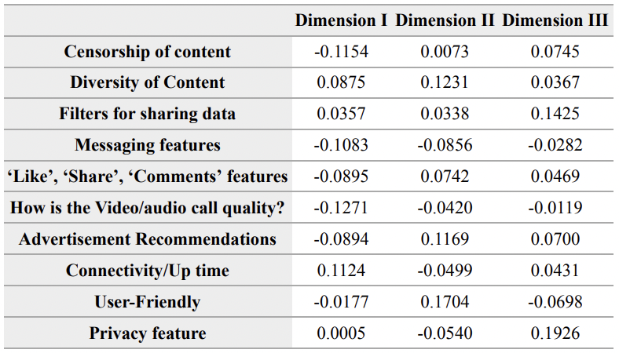
Factors loadings
Notes:
Del or not

Slide 12

Consumer Perception

Slide 13
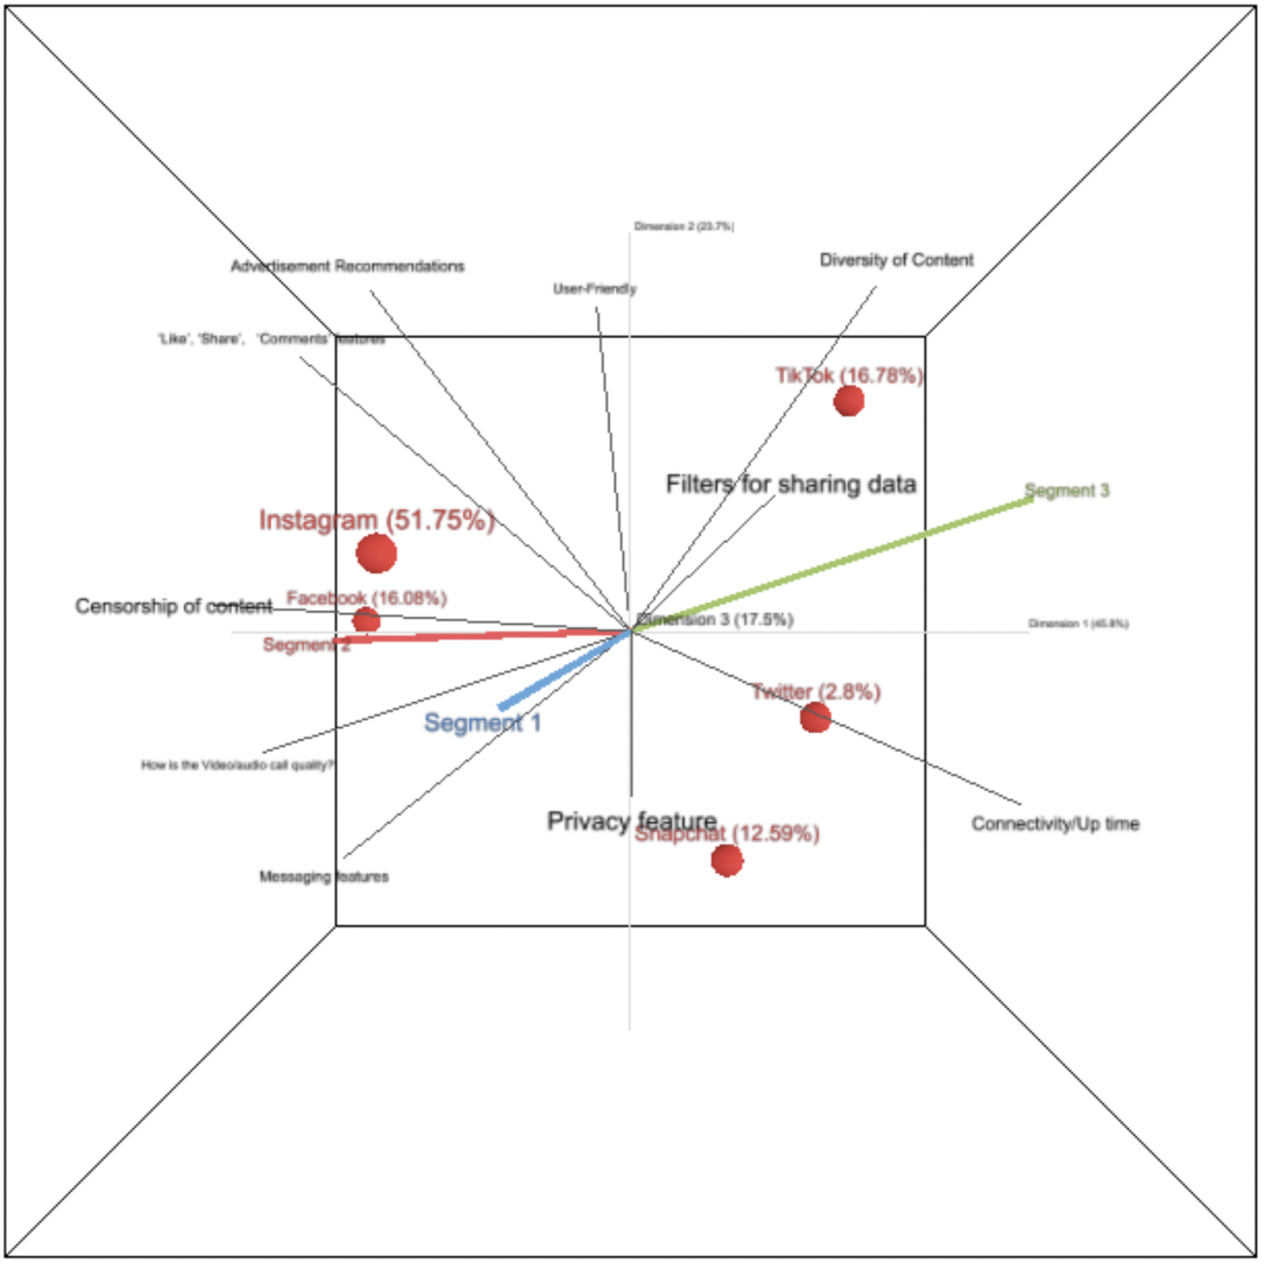
3D Visualization of Perceptual Map
Notes:
We have 5

Slide 14
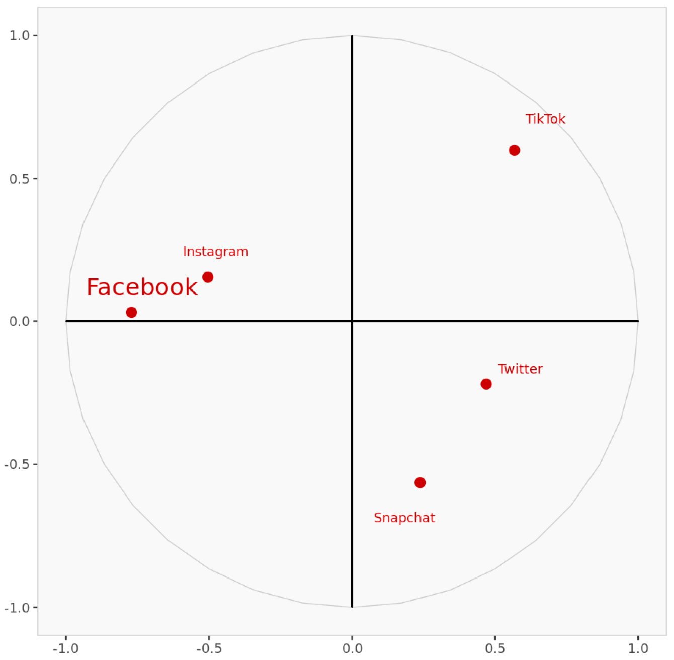
Interpretation
The more similar they are perceived to be, the more similar they rate on the underlying attributes.
Facebook as highly competitive with Instagram.
Notes:
In interpreting the map, remember that the closer two objects are,The more similar they are perceived to be, the more similar they rate on the underlying attributes. Since the first 3 dimensions of the perceptual map have been retained, the map can be seen as a cube in 3 dimensions. This view displays the cube seen from a particular angle.
We can view from the map that people in the market perceive Facebook as highly competitive with Instagram. The following table displays the coordinates of each brand viewed from dimension I.

Slide 15


CURRENT AND FUTURE POSITIONING OF FACEBOOK

Slide 16
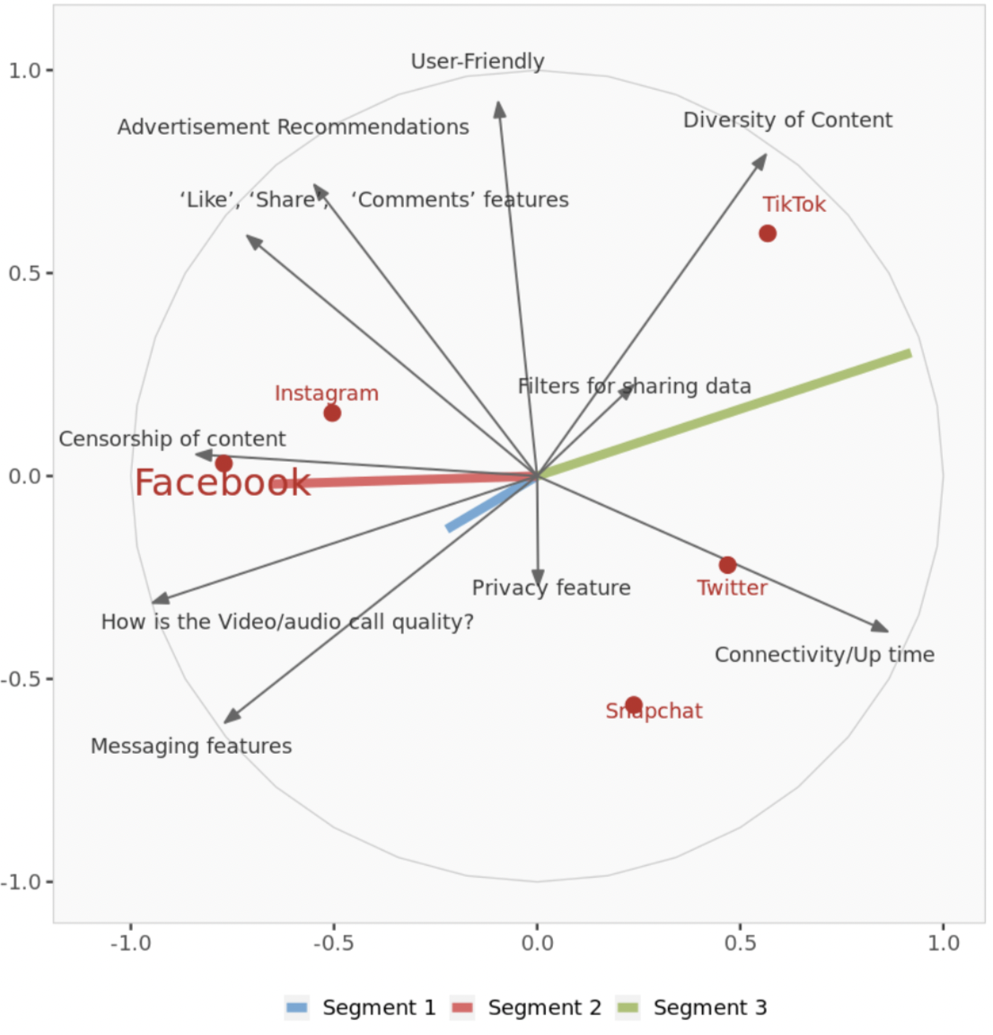
Perpetual map and segment preferences
Notes:
Complete perceptual map with objects, attributes and average segment preferences on the first and second dimensions.

Slide 17
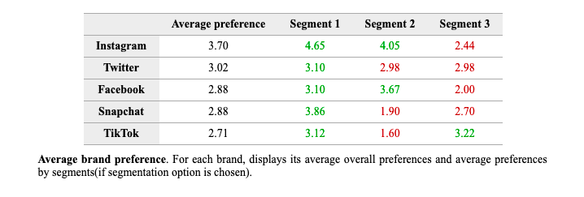
Current and Future Positioning
Facebook’s current segment:
“Segment 2” – “censor”, “Video/Audio”, “Messaging”, “Like, share, comment”, “Ads”.
Facebook current positioning: well positioned.
Two strategies we can implement:
Focus more on the segment 2 attributes to further increase the captured market area under the same segment.
Re-position to other segments as well.
We would like to re-position Facebook to “Segment – 3”
We would like to capture the market dominated by its competitors- “TikTok” and “Twitter” to increase the number of users
Notes:
Now, our aim is to increase its users. What can we do?

Slide 18

How to reposition Facebook to Segment 3?

Slide 19
9:32 am
The most essential attributes in segment 3 are "Diversity of Content" and “Connectivity”
As a result, we must concentrate on these attributes to grab the category 3 market. So, we will reposition Facebook as “Diverse Content Rich” and “Always Available”.
We can enhance following attribute:
Connectivity
Diversity of Content

Slide 20
Enhance attribute - “Connectivity”
Connectivity is a characteristic of availability. It is not possible to create an impression without being technically feasible. So, Facebook needs to improve for this attribute. Without further improvement, it is impossible to capture segment 3

Slide 21
Enhance attribute - “Diversity of Content”
Facebook already has diverse content. If users score it low, then it means that Facebook's recommendation system is not working properly. Facebook needs to understand its users more to recommend more diverse content. If the content is not available, then they should include or tweak some of its features to incorporate different types of content

Slide 22

Marketing Strategies

Slide 23

REBRANDING
Advertisement : Simply put, we will portray Facebook as “Content Diverse” and “Always Available”. We'll highlight the aspects that look to be more appealing in the third segment.
Note - Without improving in real for both the attributes: “Content Diverse” and “Always Available” , if we try to reposition it, it will work against. So, we should be very careful while handling this feature with respect to the branding.

Slide 24

REBRANDING
Positioning statement- We can tweak the current positioning statement to portray the Facebook as more content diverse. We will not change the current positioning statement. Changing the current positioning statement involves more risk. So instead of producing a new positioning statement, we will try to update the current one.

Slide 25


UPDATING POSITIONING STATEMENT
Effect?
Facebook’s Current Positioning Statement
Tweaked statement
“Anytime” here is adding for “Connectivity (availability)” and “experiencing their own world” is adding for “diverse content”
to give people the power to share and make the world more open and connected by sharing and experiencing their own world, anytime
to give people the power to share and make the world more open and connected

Slide 26



Conclusion
From our study, we figured out that Facebook lags behind in following attributes:
Diversity of Content
Filters for sharing data
Connectivity and Uptime
Privacy Features
Facebook can be repositioned to another segment of the market
Additionally, rebranding can be performed
New market can be captured by enhancing the positioning statement and the attributes

Slide 27

Thank you!
Do you have any questions?

